Slide 1
MSP x Delphi Capstone
23 March 2022
Anirban Chowdhury, Bhoomika Moorjani, Manna Zhao, Rosa Jin, April Wang
Notes:
What is the project and its context
What are current methods - current state of affairs
What are the overall issues and objectives
How will your team contribute to the project
What is the technical knowledge of the client/collaborator [either in stat/data science or in a related specialty]

Slide 2
 | Page
About the project | 3
About the client | 4
Issues and objectives | 5
Our contribution | 6
Status of the project | 7

Slide 3
About the project
Delphi Research Group
COVIDcast
Research question: “When two different data signals are supposedly getting at the same concept, do they agree?”
Notes:
Delphi is a research group based out of Carnegie Mellon University dedicated to developing the theory and practice of covid-19 tracking and forecasting. In March 2020, delphi launched COVIDcast, the nation’s largest public repository of diverse, real-time indicators of COVID-19 activity. Delphi also supports and advises the U.S. CDC’s community-driven COVID-19 forecasting effort. The COVIDcast is also the main data source we are using for our project. We will pick different pairs of signals of COVID-19 with similar concepts, and we will use statistical methods to calculate the spatial and temporal agreement to investigate whether they are in agreement.

Slide 4
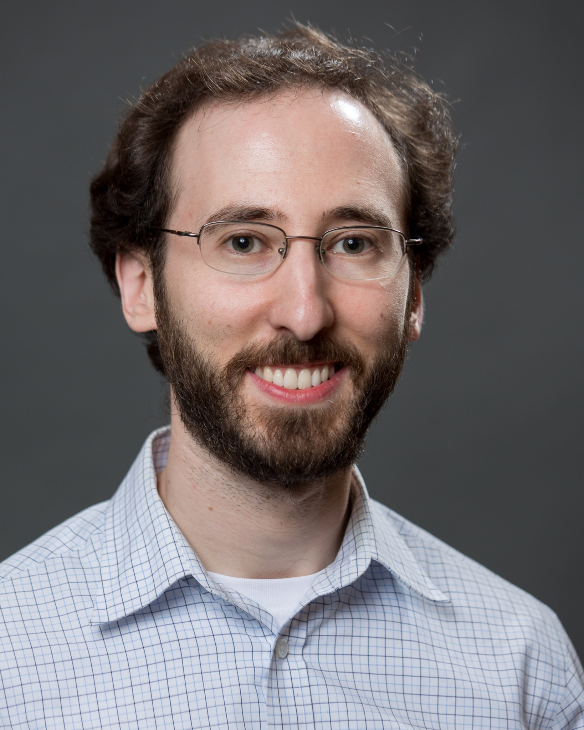
About the client
Prof. Jacob Bien
MS, PhD in Statistics, BS in Physics and Math
Core member of Delphi Group
Associate Professor of Data Sciences and Operations at the University of Southern California
Research focused on statistical machine learning, high-dimensional convex optimization

Slide 5
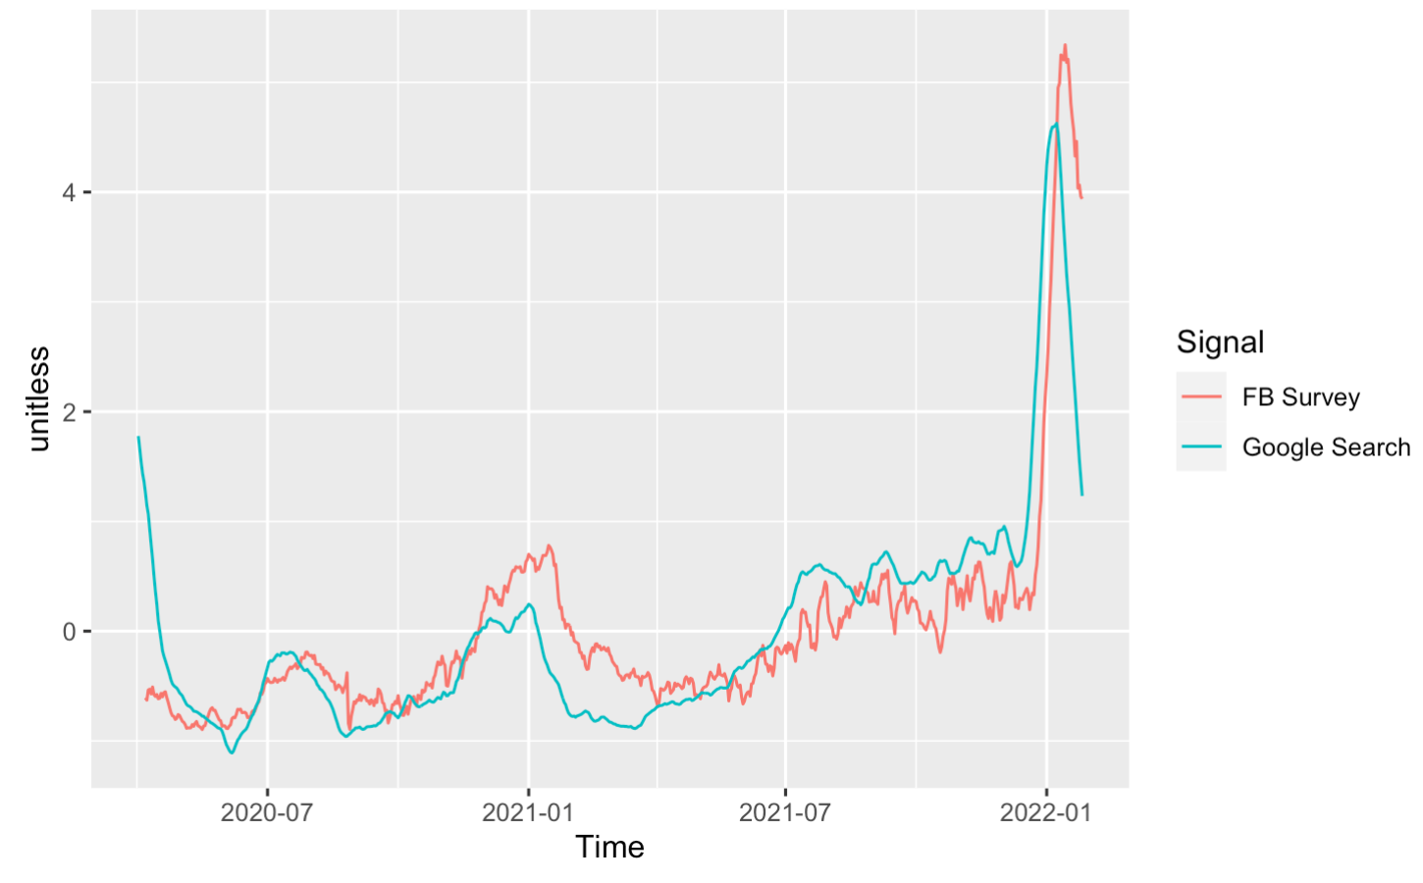
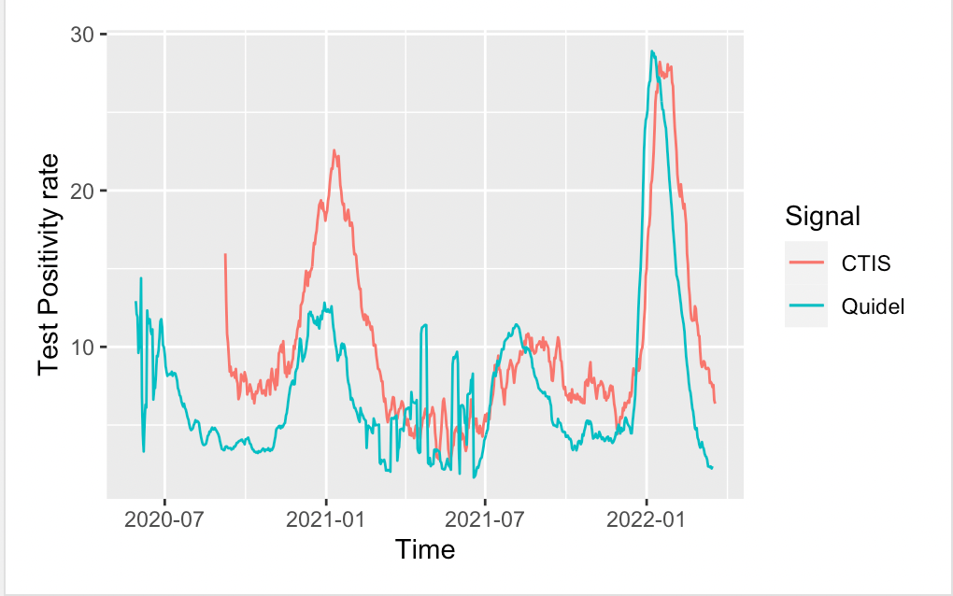
Objectives and issues
Objectives:
Measure agreement between two pairs of signals
Exploring possible reasons of disagreement
Issues
Data inconsistency over time / space
Notes:
date
range
counties: missing data
Identify and implement effective statistical methods to determine if two signals are in agreement
Investigate and provide insights into
Data from different signals are inconsistent over time / space

Slide 6
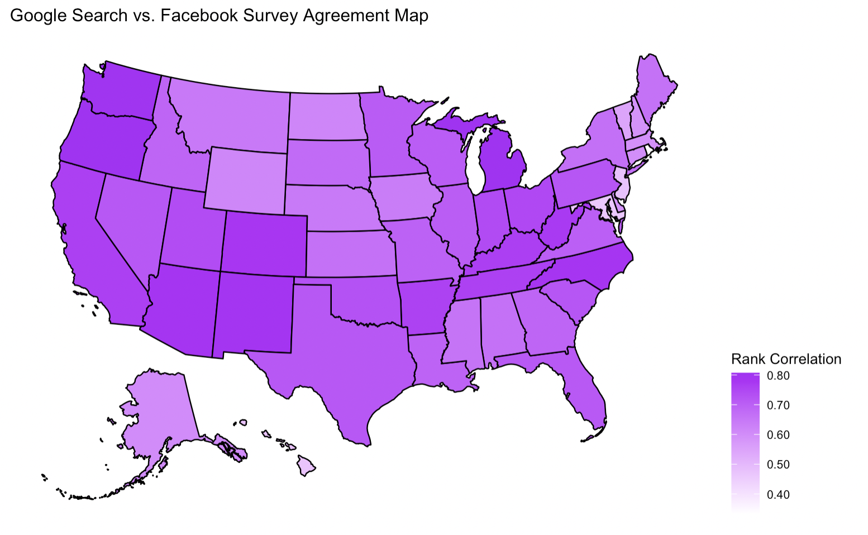
Contribution / Status of the project
Sore throat cases from CTIS vs. search volume on Google
Rank correlations across states
Explore reasons for pattern
Population size
Digital media habits
Next Steps:
County-level
Correlation over time
Notes:
To explain possible reasons for correlation differences between states, our guesses are:
Population size: small population - less cases - less care about symptoms
Digital media: different habits in using Google, any other digital media
County-level analysis

